Slide 1


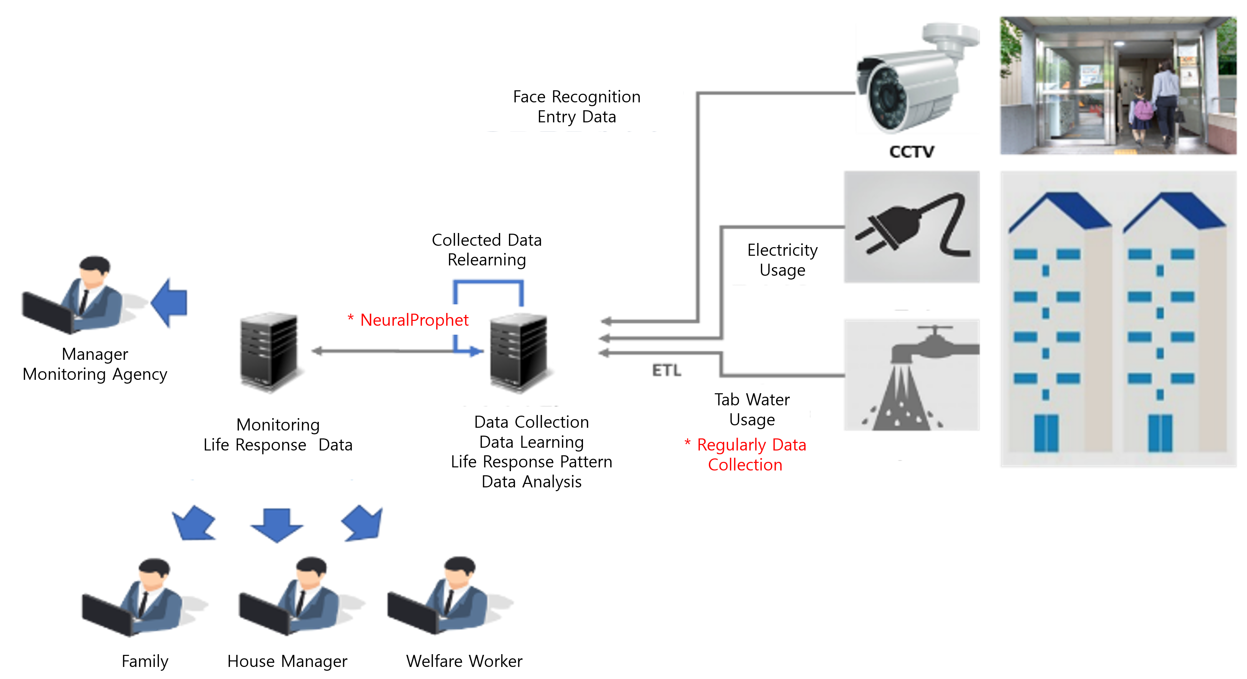
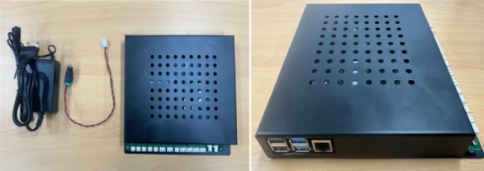
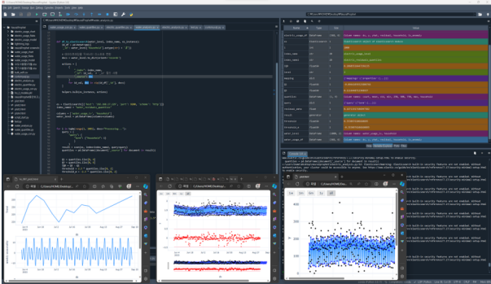
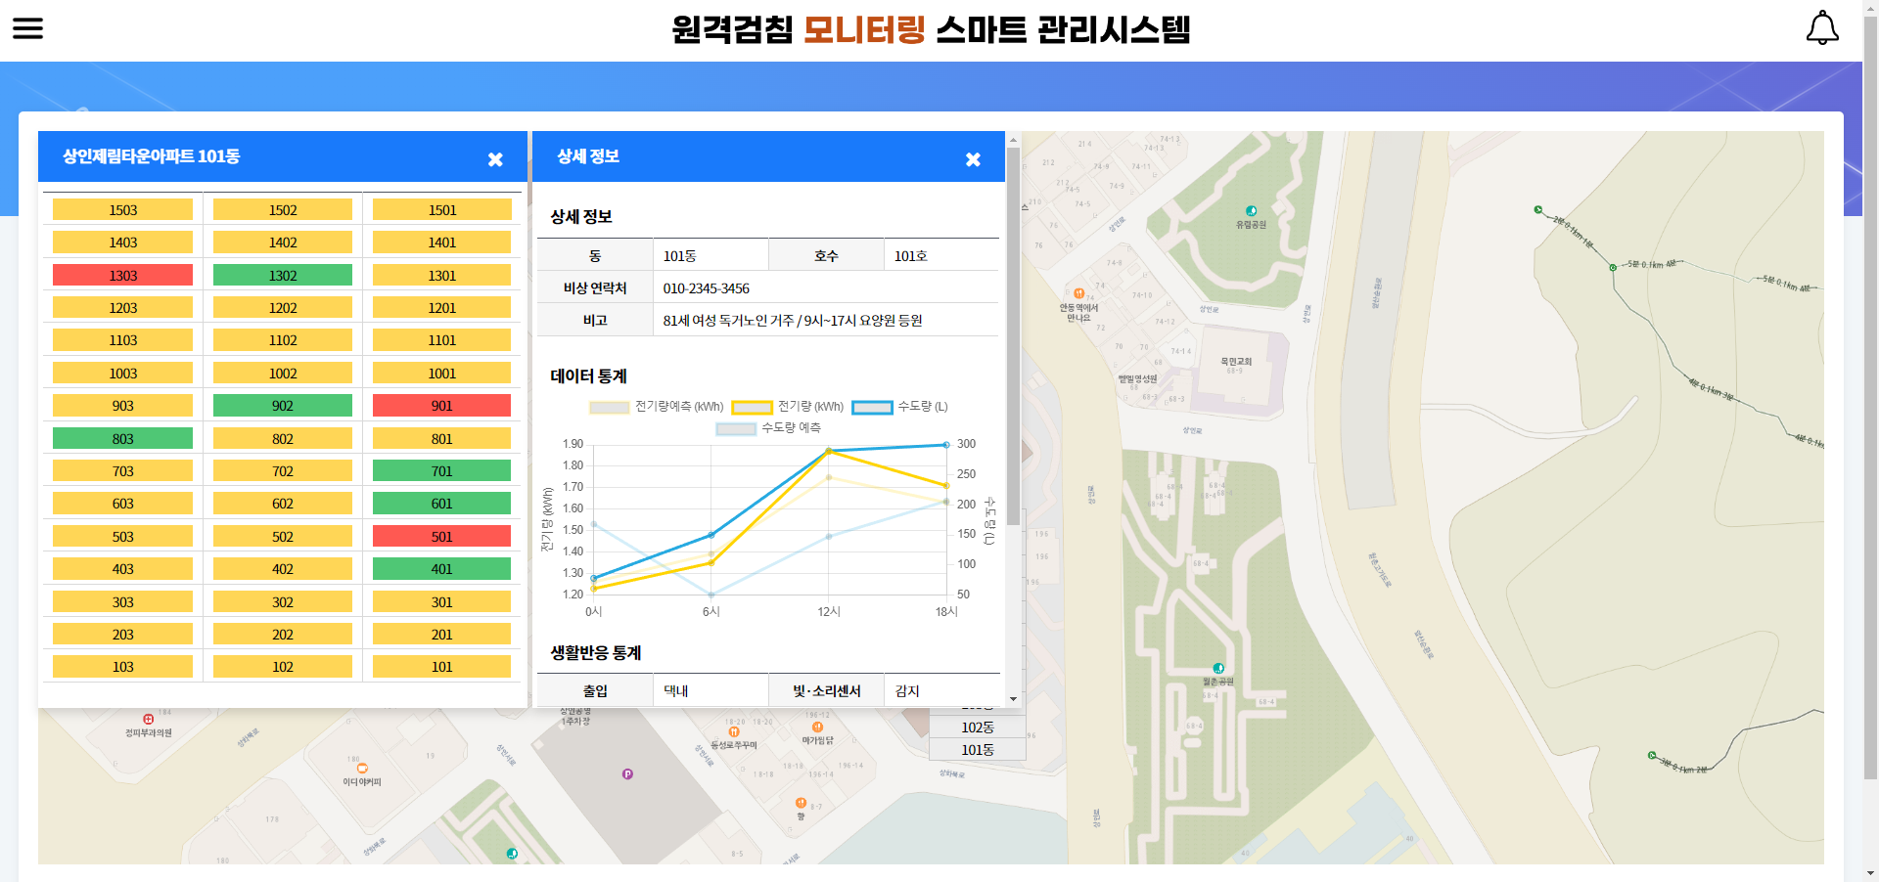
Development of a Smart Early Detection System for Solitary Deaths Based on Life Response Data
Jon, YongJun¹, Bo-Mi Lee², Jae-Pil Jung², Ye-Gyun Kim², Young-Ho Shin², SungBum Kang³
¹Dept. of AI & Big Data, Daegu Catholic University, Gyeongsan, Rep. of Korea
²Gyeongbuk ICT Advanced Talent Training Center, Daegu Catholic University, Gyeongsan, Rep. of Korea
³Bumil Information Co., Ltd. R&D Department, Daegu, Rep. of Korea
ABSTRACT
This study developed a smart early detection system for solitary deaths in South Korea using life response data. The system analyzes living patterns of elderly people living alone, detecting abnormal signs based on remote meter reading data and CCTV entry information. It integrates an AI-based data analysis model with a GIS-based monitoring system. Experimental results showed high performance in data collection, analysis, and relearning speeds. This system is expected to contribute to preventing solitary deaths and improving the quality of life for elderly people living alone.
INTRODUCTION
South Korea faces a rising number of elderly people living alone due to rapid aging and increasing single-person households. The 2022 solitary death survey by the Ministry of Health and Welfare shows an upward trend in solitary deaths, particularly among the elderly in their homes. Solitary death, discovered after a period following an individual's death alone, raises concerns about personal dignity and social costs. This study aims to develop an early detection system for solitary deaths using life response data.
Design and IMPLEMENTAION
1. System Architecture
The System Components
Life response data collection system
AI analysis model for life response data
Monitoring system for vulnerable groups
2. Data Collection and AI Based Analysis Model
Data Collection and Storing to Database
Remote meter reading equipment collects electricity and water usage data
CCTV entry information is gathered from main entrances
Data is preprocessed and stored in a MySQL database
AI Analysis Model
Implemented using NeuralProphet
Features include learning of trends, seasonality, and anomaly detection
4-level classification: Normal, Caution, Warning, Danger
Fig 1. System structure diagram
Fig 2. Embedded data collection equipment and learning data
3. Monitoring System and Face Recognition
Running and management
GIS-based UI for visualizing data and managing alerts
SMS notification function with error minimization algorithm
Face Recognition System
Uses RetinaFace for face detection
CNN-based model for face learning
4. Experiments and Results Analysis
Experiments conditions and evaluation
Experimental setup : 1,000 data points each for 1,000 water and electricity meters
Evaluation: Data collection speed, analysis speed, relearning speed
Environment: VM-based server with Elastic/Opensearch
Experiments Results
The system significantly outperformed targets in all evaluation areas
Evaluation Item | Target | Actual Result
Data collection speed | 3 seconds/case | 0.013 seconds/case
Data analysis speed | 2 seconds/case | 0.037 seconds/case
Relearning speed | 40 seconds/case | 8.2 seconds/case
Fig 3. Main screen of life response monitoring platform
Table I. Evaluation system test results
Conclusion
This study developed an early detection system for solitary deaths using on-device life response data. Key achievements include non-invasive monitoring, data analysis, GIS-based UI, and face recognition entry management. Future improvements involve expanding applicability, enhancing performance, and linking with other services. The system aims to prevent solitary deaths and improve quality of life for elderly and single-person households.
Acknowledgment
This research was supported by "Regional Innovation Strategy (RIS)" through the National Research Foundation of Korea (NRF) funded by the Ministry Education (MOE)(project Management Number: 2022RIS-006)

